Slide 1

Weatherization Tool: Mobile, Standalone, and Paper Model
David Williams, Osama Akhtar, Gilbert Addae-Konadu
CIS 691
CIS Dept, Clark Atlanta University
Spring 2014, Dr. O

Slide 2
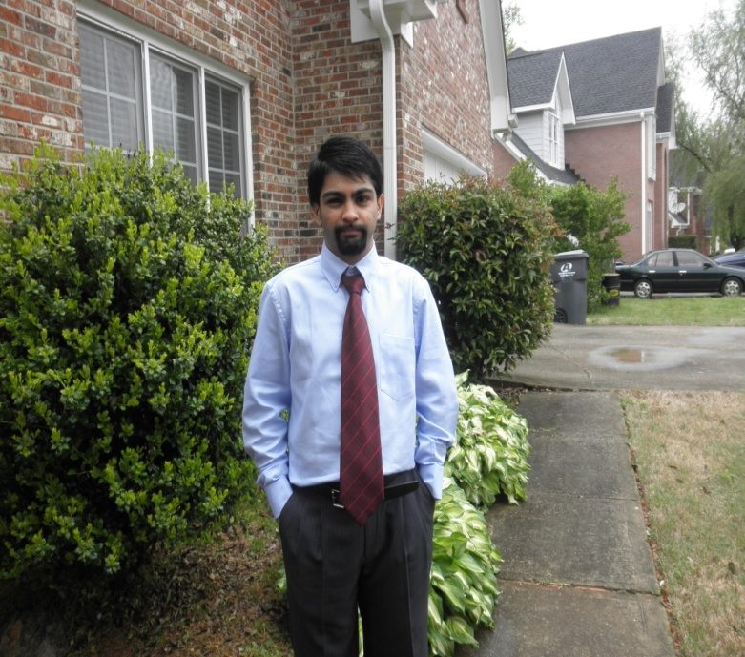


Project Team Member Pictures
Gilbert
Addae-
Konadu
Osama
Akhtar
David Williams

Slide 3
Overview
Introduction
Overview
Diagrams
Questions

Slide 4
Introduction
This project is about creating a weatherization tool to make homes more energy efficient.
We used 3 different methods: paper, mobile, standalone, etc.
This is one major area that can create millions of jobs in the United States and countries around the world.

Slide 5
Project Partners Participation
David – Designed the IEEE format paper, designed the Java standalone program, and made the CD
Gilbert – Designed the Android, App, coordinated and helped with the Java standalone program, and made the User’s Manual for the Paper Ver, Java standalone program, and the Android App
Osama – Designed the final ppt presentation, made the 12 diagrams in UML, researched and designed the mobile Android App database

Slide 6
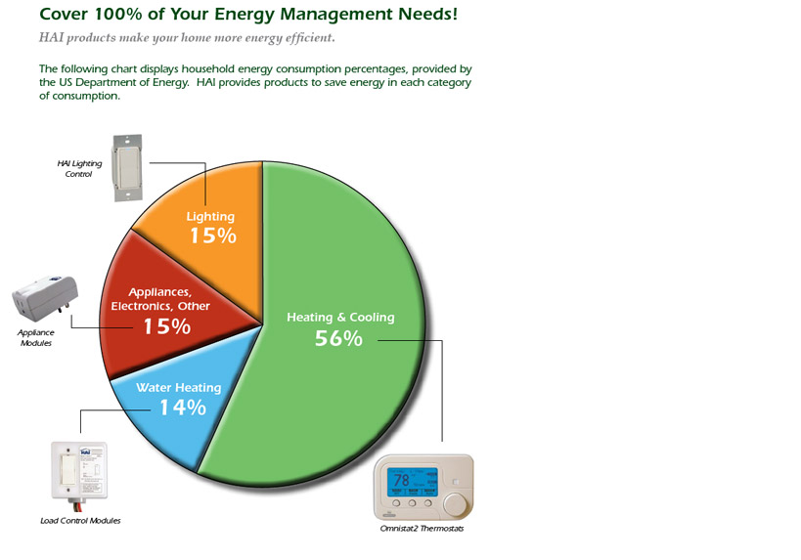
Pie Chart – Areas of Energy

Slide 7
Waterfall Life Cycle Model
Requirements
Design
Analysis
Implementation
Testing
Post-production

Slide 8
Paper Version
This version is a paper version users can fill out known as a questionnaire. It is a comprehensive overview of one’s residence and gives an accurate outlook to the user if any weatherization needs to occur.
Following are four diagrams covering this version.

Slide 9
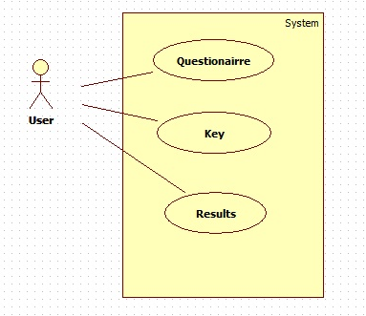
Paper Ver. - Use Case Diagram
Below is a use-case diagram which places the User as an actor:

Slide 10
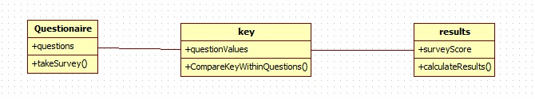
Paper Ver. - Class Diagram
The following is a class diagram showing the interactions between the User and the use cases thus the 3 class:

Slide 11
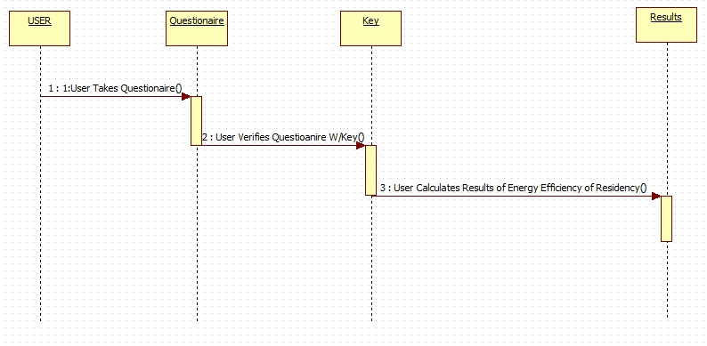
Paper Ver. - Sequence Diagram
Below shows the sequence diagram with the actors and use case as blocks:

Slide 12
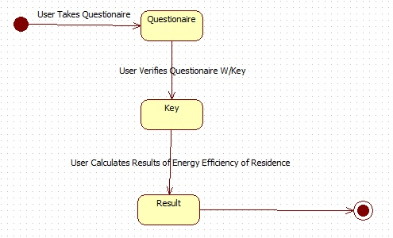
Paper Ver. - Statechart Diagram
Below is a statechart diagram that displays the sequence diagram:

Slide 13
Standalone Version
This is a version that uses the object-oriented language called Java to create a comprehensive program users can fill out.
Java was chosen because of group members familiarity with the programming language.

Slide 14
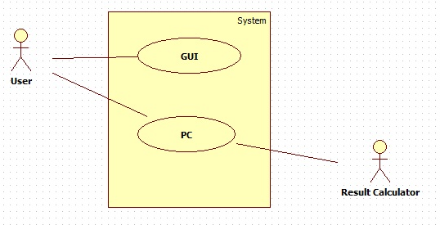
Standalone Ver. – Use Case Diagram
This is the Use Case diagram for the standalone version with updates from the paper version:

Slide 15
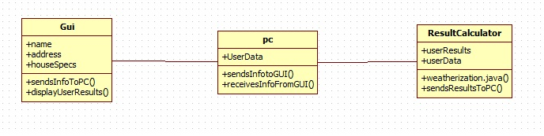
Standalone Ver. – Class Diagram
Below is the Class diagram for the standalone version updated from the paper version:

Slide 16
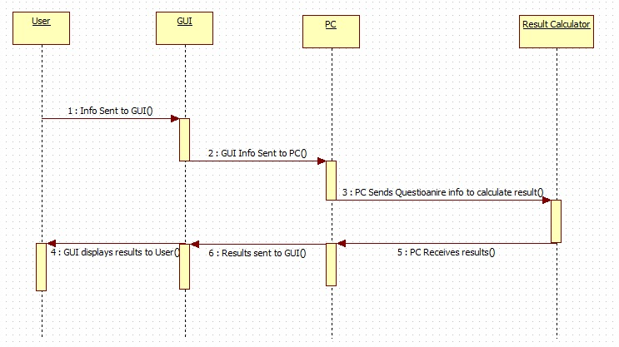
Standalone Ver. – Sequence Diagram
Below is the sequence diagram:

Slide 17
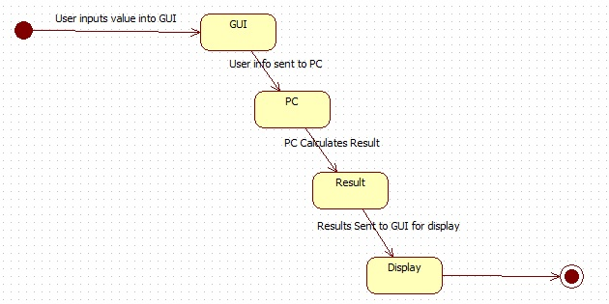
Standalone Ver. – Statechart Diagram
Below is the statechart diagram for the standalone version:

Slide 18
Mobile Android Version
This is the 3rd and final version of our weatherization tool.
This version is a mobile version with the android app that can be accessed via internet and any mobile device such as laptops, cell phones, tablets, etc.
It was built using MIT AI2 App Inventor, an android programming tool.
Use a NoSQL database called TinyDB which is a key value store.

Slide 19
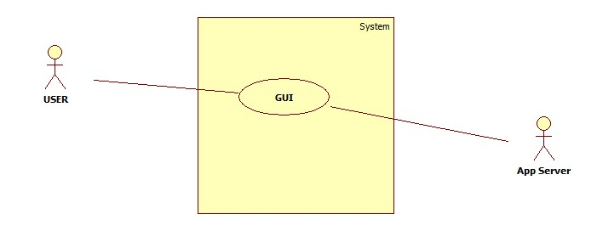
Mobile Ver. – Use Case Diagram
Mobile Use Case Diagram that uses an app server:

Slide 20
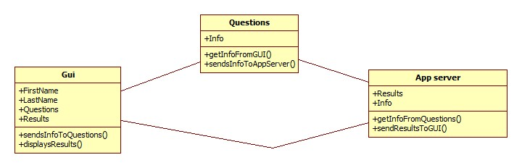
Mobile Ver. – Class Diagram
Mobile Class Diagram:

Slide 21
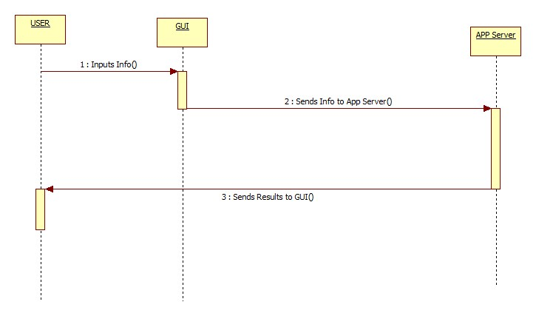
Mobile Ver. – Sequence Diagram
Mobile Version Sequence Diagram:

Slide 22
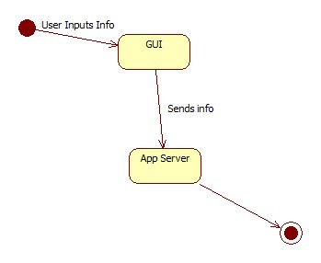
Mobile Ver. – Statechart Diagram
Mobile Version Statechart Diagram:

Slide 23
Software Code
The software code was a code of the questionnaire done in Java:
class SecondStep extends JPanel {
private JRadioButton North_Georgia = new JRadioButton("North Georgia", true);
private JRadioButton Atlanta_Metro = new JRadioButton("Atlanta Metro");
private JRadioButton Coastal_Georgia = new JRadioButton("Coastal Georgia");
private JRadioButton South_Georgia = new JRadioButton("South Georgia");
private JRadioButton Single_Story = new JRadioButton("Single Story", true);
private JRadioButton Multi_Story = new JRadioButton("Multi Story");
private JRadioButton Apartment = new JRadioButton("Apartment");
private JRadioButton Town_House = new JRadioButton("Town House");
private JRadioButton YearCategory_1 = new JRadioButton("1950 or earlier", true);
private JRadioButton YearCategory_2 = new JRadioButton("1951 to 1970");
private JRadioButton YearCategory_3 = new JRadioButton("1971 to 1990");
private JRadioButton YearCategory_4 = new JRadioButton("1991 to Present");
private JRadioButton Drafty = new JRadioButton("Drafty/Street Noise", true);
private JRadioButton IDoNotKnow = new JRadioButton("Typical/I Don't Know");
private JRadioButton HomeownerWeatherized = new JRadioButton("Homeowner Weatherized");
private JRadioButton ProfessionallyWeatherized = new JRadioButton("Professionally Weatherized");
private JRadioButton Yes = new JRadioButton("Yes", true);
private JRadioButton No = new JRadioButton("No");

Slide 24
Discussion/Results
The programming was fairly easy to do and achieved well with few issues.
The Android mobile app was simplified to make it user-friendly.

Slide 25
Future Work
Contacting the Georgia Environmental Finance Authority (GEFA) for interest
Possible expansions with the Java standalone program with Windows, Mac, and Linux systems including developing a standalone database
Improve mobile app

Slide 26
Conclusion
There was no team leader and each group member contributed equally.
The format of the project proposal and the group allowed learning to be efficient and easy.
We would like to thank Dr. Olatidoye for this challenging project and allowing us to think outside the box.

Slide 27
References
[1] “Environmental and Energy Study Institute “: http://www.eesi.org/092812weatherization [Accessed: April 20, 2014].
[2] “Learn More about Georgia’s Weatherization Assistance Program”: http://georgia.gov/blog/2013-11-18/learn-more-about-georgia%E2%80%99s-weatherization-assistance-program [Accessed: April 25, 2013].
[3] Leviton Security and Automation: http://www.homeauto.com/products/products_main.asp [Accessed: March 25, 2014].
[4] AI2 App Inventor: http://ai2.appinventor.mit.edu [Accessed: March 20, 2014].

Slide 28
Questions
The floor is open for questions.
?

